Slide 1
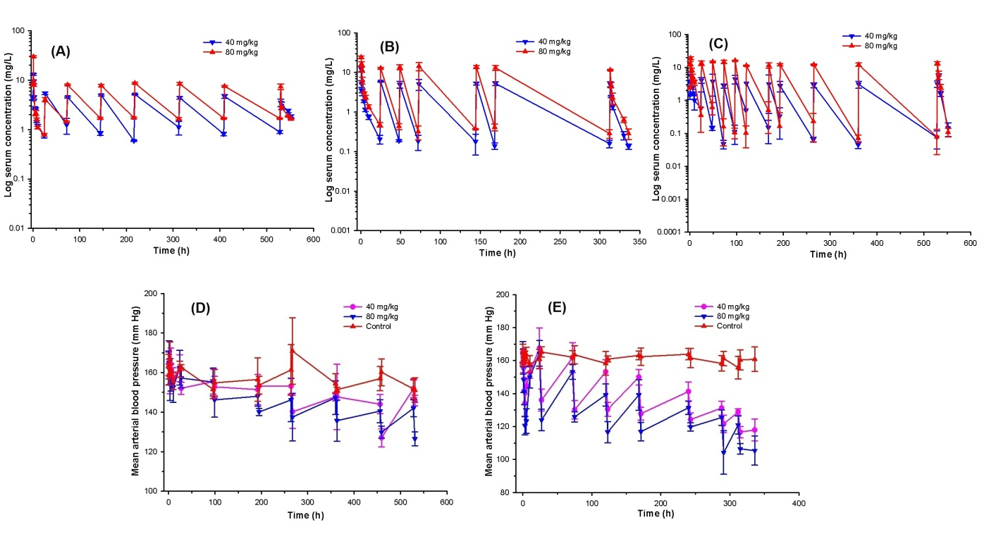
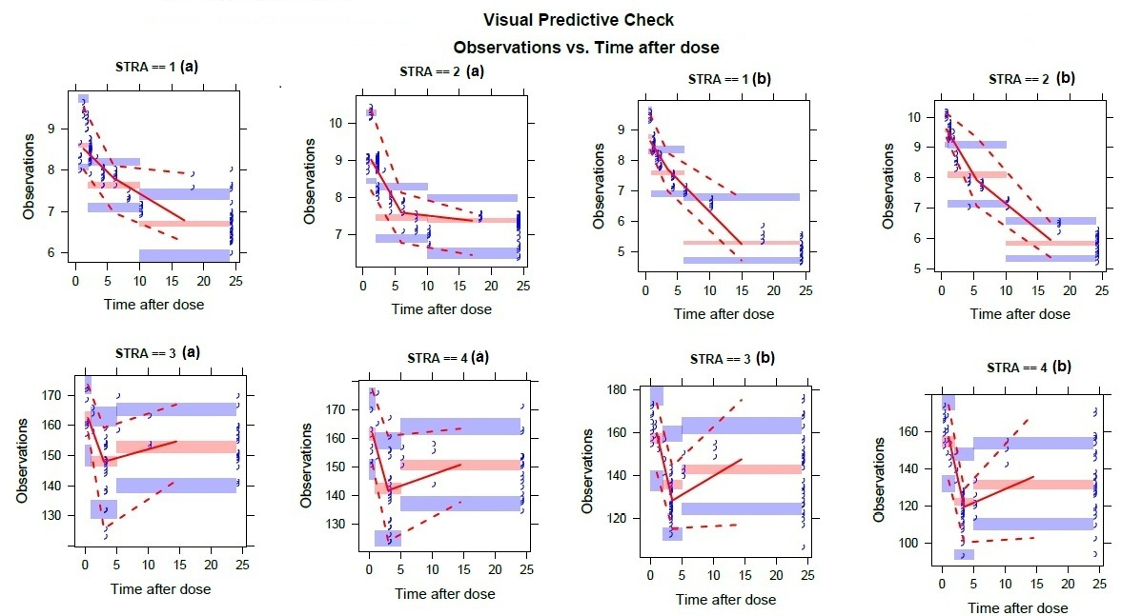
Population pharmacokinetic-pharmacodynamic modeling of furosemide for anti-hypertensive effect
Mahendra Shukla^{1,2} , Moon Jain^{2,3}, Swati Jaiswal^{1,2} , Abhisheak Sharma^{1,2,4} , Kashif Hanif^{2,3} and Jawahar Lal^{1,2}
¹Pharmacokinetics & Metabolism Division, CSIR-Central Drug Research Institute, Lucknow -226031, India, ²Academy of Scientific and Innovative Research, New Delhi -110001, India, ³Pharmacology Division, CSIR-Central Drug Research Institute, Lucknow-226031, India, ⁴Department of Pharmaceutics, University of Florida, Gainesville, FL, 32610, USA
shukla.mahendra07@gmail.com
BACKGROUND AND OBJECTIVES
Despite its long term use as an established diuretic, the anti-hypertensive effect of furosemide has not been well characterized. The previous PK-PD studies of furosemide mainly modeled its diuretic effect [1]. The reports pertaining to the use of furosemide in treating different forms of hypertension are limited. The multiple dose studies for the anti-hypertensive effect of furosemide are lacking.
The present study aims at bridging this void by providing a comparative PK-PD analysis for the BP lowering effect of furosemide after multiple dosing in spontaneously hypertensive rats (SHR) and deoxycorticosterone acetate-salt-induced hypertensive rats (DOCA-salt rats), the commonly employed animal models for human primary and secondary hypertension respectively.
METHODS
PK-PD study of furosemide was carried out post multiple oral dose (40 and 80 mg/kg once daily for 3 weeks) in SHR and DOCA-salt rats. Blood samples were withdrawn up to three weeks post treatment and harvested serum samples were analyzed using LC-MS/MS method [2]. For PD study, BP was monitored using noninvasive BP monitoring in conscious rats using tail cuff method at various predefined time points. A simultaneous population PK-PD relationship using E_{max} model with effect compartment was developed to compare the anti-hypertensive efficacy of furosemide in these rat models. Analysis was conducted using NONMEM 7.3.
RESULTS
Fig. 1. Log serum concentration versus time profile of furosemide following 40 and 80 mg/kg multiple oral dosing in (A) SHR, (B) DOCA-salt rats, (C) normotensive Wistar control rats and mean arterial BP versus time profile in (D) SHR, (E) DOCA-salt rats.
Fig. 2. Stratified visual predictive check plots indicating observations versus time after dose in SHR [STRA==1(a), 2(a), 3(a), 4(a)] and DOCA-salt rats [STRA==1(b), 2(b), 3(b), 4(b)]. The observations in STRA== 1(a) and 1(b) represent serum concentrations following 40 mg/kg and STRA== 2(a) and 2(b) following 80 mg/kg multiple oral dose of furosemide. The observations in STRA== 3(a) and 3(b) represent mean arterial BP following 40 mg/kg and STRA== 4(a) and 4(b) following 80 mg/kg multiple oral dose of furosemide.
Parameters | Estimate (% RSE*) |  | Bootstrap mean |  | 95% Confidence Interval
 | SHR | DOCA-salt | SHR | DOCA-salt | SHR | DOCA-salt
PK parameters
Alpha (α) | 0.89 (6.0) | 0.02 (4.0) | 0.89 | 0.02 | 0.78-1.02 |  | 0.02-0.03
Beta (β) | 3.06 (5.1) | - | 3.11 | - | 2.71-3.52 |  | -
CL (L/h) | 0.17 (4.5) | 0.26 (2.4) | 0.17 | 0.26 | 0.16-0.19 |  | 0.25-0.27
V1 (L) | 0.27 (18.2) | 0.32 (4.7) | 0.27 | 0.31 | 0.17-0.39 |  | 0.27-0.32
V2 (L) | 1.89 (2.8) | 1.24 (3.2) | 1.88 | 1.22 | 1.74-1.97 |  | 1.16-1.31
Q | 0.49 (4.6) | 0.32 (3.9) | 0.49 | 0.32 | 0.44-0.55 |  | 0.29-0.34
Dose on α | 1.05 (3.8) | - | 1.04 | - | 0.95-1.13 |  | -
Dose on CL | 1.66 (6.0) | - | 1.66 | - | 1.42-1.85 |  | -
Dose on V1 | - | 1.62 (10.7) | - | 1.74 | - |  | 1.58-2.22
Dose on V2 | 2.56 (7.6) | - | 2.57 | - | 2.27-3.24 |  | -
σ_{additive} | 0.23 (9.2) | 0.25 (6.4) | 0.22 | 0.25 | 0.18-0.26 |  | 0.21-0.28
σ_{proportional} | 252 (22.3) | - | 233.78 | - | 136.42-357.06 |  | -
PD parameters
K_{e} | 0.15 (36.5) | 0.06 (13.9) | 0.16 | 0.07 | 0.08-0.34 |  | 0.06-0.09
Slope | 55.60 (29.6) | 12.9 (5.8) | 60.05 | 12.20 | 37.60-106.48 |  | 10.78 -13.07
Intercept (mmHg) | 162.37 (0.9) | 163.24 (1.0) | 162.39 | 163.93 | 159.72-167.57 |  | 161.74 -167.33
TEFF | -0.0001 (23.4) | -0.0001 (6.3) | -0.0001 | -0.0001 | -0.0002 to -0.0001 |  | -0.0004 to -0.0001
TOLE | -0.16 (17.1) | -0.33 (15.3) | -0.17 | -0.29 | -0.2 to -0.11 |  | -0.35 to -0.20
EC₅₀ (μg/mL) | 9.1 | 4.2 | - | - | - |  | -
σ_{proportional} | 0.05 (10.3) | 0.06 (5.7) | 0.04 | 0.06 | 0.04-0.06 |  | 0.05-0.07
Abbreviations: Alpha and beta=scaling factors, CL=clearance, V1 and V2= volume of distribution of central and peripheral compartment, Q = inter-compartmental clearance, σ_{additive} = additive residual variability, σ_{proportional} = proportional residual variability, K_{e} = rate constant for drug transfer from central to effect compartment, EC₅₀ = concentration at half maximal effect, TOLE= Tolerance, Slope= EC50/TOLE, Intercept=Baseline BP; *from bootstrap analysis.
A two-compartment model with Weibull-type absorption and first-order elimination best described the serum concentration-time profile of furosemide. A combined additive with proportional error models for residual variability were found to best describe the data. Body weight of rats was included as a covariate affecting CL and the DOSE was included as a covariate affecting α, CL and V2 for SHR and V1 for DOCA-salt rats. The VPC plots stratified on the basis of dose demonstrated reasonable agreement between 20th, 50th and 80th percentiles of the observed and simulated serum concentrations.
The baseline BP value was found to be almost similar (163 mm Hg) between the two models. The E_{max} was fixed to 1 (100%) and the EC₅₀ between SHR and DOCA-salt rats was compared. The clock-wise hysteresis clearly indicated PD tolerance. The EC50 in DOCA-salt rats was found to be much lower (2.2-fold) as compared to SHR; however, the tolerance was found to be much higher.
CONCLUSION
An E_{max} model with effect-compartment well characterized the anti-hypertensive effect of furosemide mediated either through diuresis or other probable pleiotropic effects. Model based predictions provided supportive evidence for the higher BP lowering efficacy of furosemide in secondary hypertension. Our studies also suggest the need of adjustment in the currently prescribed dose of furosemide for better anti-hypertensive effect.
REFERENCES
MM Hammarlund, B Odlind, LK Paalzow. Acute tolerance to furosemide diuresis in humans: Pharmacokinetic-pharmacodynamic modeling. J Pharmacol Exp Therap 1985; 233(2): 447-53.
ME Abdel-Hamid. High-performance liquid chromatography-mass spectrometric analysis of furosemide in plasma and its use in pharmacokinetic studies. Farmaco 2000; 55(6-7): 448-54.
Population Approach Group in Europe-2017 meeting, Budapest, Hungary

